Slide 1
Nested Loop & Star Pattern
Day4_of_100_Days_Of_Code_Challenge

Slide 2
Nested Loop
Looping is Defined As Multiple Time Of Repeatation Of Particular statements Until a specific Condition Satisfies and when a loop inside the loop then it is Called Nested Loop
Syntax:- For(initialization;condition;increment/decrement){
For(initialization;condition;increment/decrement){
Statement;
}
}

Slide 3
Example of Nested Loop
package com.company; import java.util.Scanner; import java.util.concurrent.SynchronousQueue; public class practice51 { public static void main(String[] args) { Scanner sc = new Scanner(System.in); System.out.println("enter the number of row:"); int n = sc.nextInt(); for (int i=n;i>=0;i--) { for (int j=0;j<=i;j++) { System.out.print("*"); } System.out.println("\n"); } } }

Slide 4
Star Pattern
Star Pattern is the Best Example of Nested Loop it is a set of Many Geomerical Pattern .it helps to Improve Logical Thinking

Slide 5
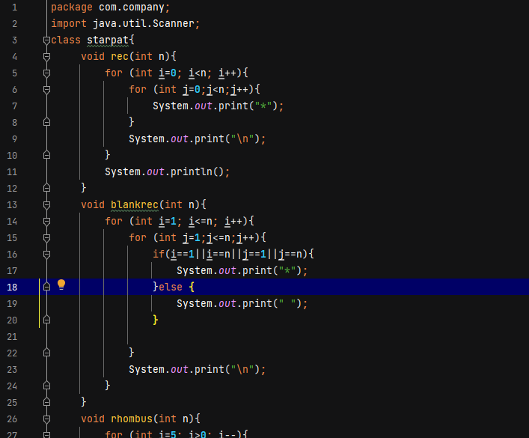
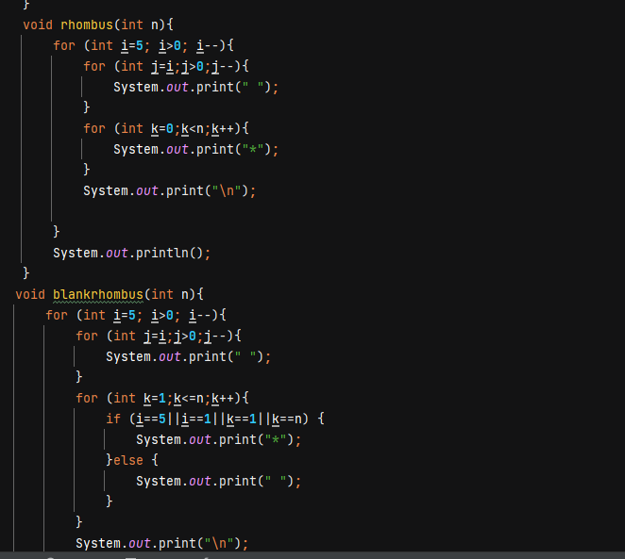
Example of Star Pattern

Slide 6
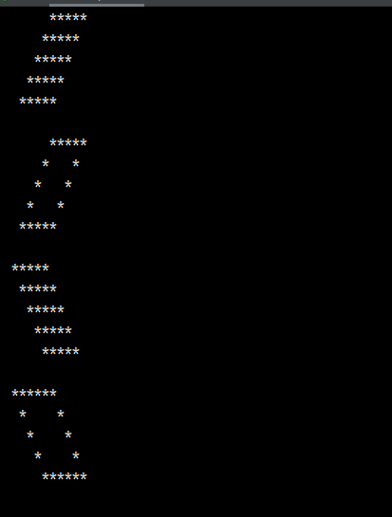
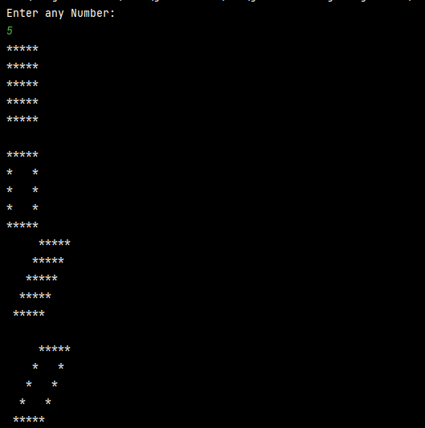
Output

